Slide 1
CHAPTER 9
CIVIL LITIGATION: BEFORE THE TRIAL

Slide 2

Introduction
Every paralegal should be acquainted with the basic phases of civil litigation and the forms and terminology commonly used in the process
Evidence must be gathered and documented
Procedural requirements and deadlines for filing documents with the court must be met
Witnesses must be prepared in advance
Any trial exhibits must be properly prepared

Slide 3
Civil Litigation—A Bird’s-Eye View
Pretrial Settlements
  Out-of-court resolution of the dispute
  Reached in most cases
  In the interest of both parties to settle
    Time and money
  Must work on assumption that case will go to trial
  All pretrial preparation must be completed
Notes:
Learning Objective: The basic steps involved in the civil litigation process and the types of tasks that may be required of paralegals during each step of the pretrial phase.

Slide 4
Civil Litigation—A Bird’s-Eye View
Procedural Requirements
  Essential in the litigation process
  Set out in the procedural rules of each court
    Rules specify what must be done in various stages
  Each state has its own rules of civil procedure
  A Hypothetical Lawsuit
      Katherine Baranski, plaintiff
      Tony Peretto, defendent

Slide 5
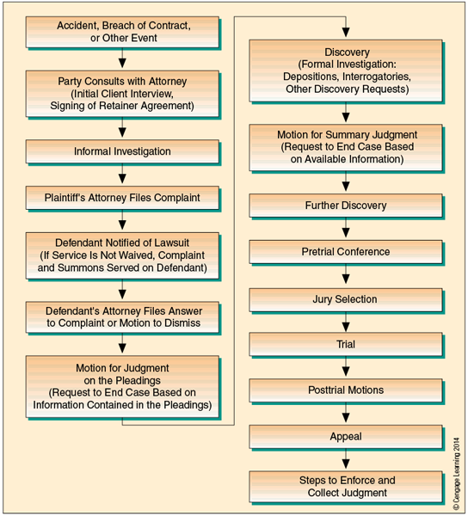
Civil Litigation—A Bird’s-Eye View

Slide 6
The Preliminaries
The Initial Client Interview
  Most often conducted by attorney
    Explain his services
    Agree to represent
    Set fees
  Collecting Facts
  Release Forms

Slide 7

The Preliminaries
Preliminary Investigation
  Key part of pretrial work
  Police report
  Medical records
  Employment data
  Eyewitness accounts

Slide 8
The Preliminaries
Creating the Litigation File
  Organization
    Three goals
      Preserve confidentiality
      Safeguard legal documents
      Easily and quickly retrievable
  Litigation Files
    Comprehensive record of the case
    Must be well organized
Notes:
Learning Objective: What a litigation file is, what it contains, and how it is organized, maintained, and reviewed.

Slide 9
The Pleadings
Drafting the Complaint
  The Caption
    Heading: name of court, title of action, names of parties, type of document, court’s file number (or docket number)
  Jurisdictional Allegations
    Diversity of citizenship
  General Allegations (The Body of the Complaint)
    Advocate the plaintiff’s position
    Be clear and concise
    Outline harms suffered and remedy sought
    Cont.
Notes:
Learning Objective: How a lawsuit is initiated and what documents and motions are filed during the pleadings stage of the civil litigation process.

Slide 10
The Pleadings
Drafting the Complaint
  Prayer for Relief
    Indicate seeking money damages
  Signature
    Affidavits
  Demand for a Jury Trial

Slide 11
The Pleadings
Filing the Complaint
  Traditional Method of Filing
    Copies hand delivered
    Filing fee
  E-Filing
    Reduced time and paperwork
    24 hours a day

Slide 12
The Pleadings
Service of Process
  The Summons
  Serving the Complaint and Summons
    Alternative service methods
    Proof of service
    Jurisdictions vary
  Serving Corporate Defendants
  Finding the Defendant
  The defendant Can Waive Service

Slide 13
The Pleadings
The Defendant’s Response
  The Answer
    Answer and affirmative defense
    Answer and counterclaim
    Cross-claim
  Filing a Motion
    Motion to dismiss
      Supporting affidavits
      Memorandum of law

Slide 14
The Pleadings
The Scheduling Conference
  Attorneys from both sides
  Scheduling order
  FRCP 16(b)
  Manage the case efficiently
  Establish time restrictions

Slide 15
Traditional Discovery Tools
Purpose of Discovery
  Preserves evidence from witnesses
  Can lead to an out-of-court settlement
  Prevents surprises
  Narrows the issues
  Privileged information is safeguarded
Notes:
Learning Objective: What discovery is and what kinds of information attorneys and their paralegals obtain from parties to the lawsuit and from witnesses when preparing for trial.

Slide 16
Traditional Discovery Tools
Interrogatories
  Written questions that must be answered in writing
  Drafting Interrogatories
    Review the file
    Courts may limit the number of interrogatories
  Answering Interrogatories

Slide 17
Traditional Discovery Tools
Depositions
  Procedure for Taking Depositions
  Drafting Deposition Questions
  Preparing the Client for a Deposition
  The Role of the Deponent’s Attorney
  The Deposition Transcript
  Summarizing and Indexing the Deposition Transcript

Slide 18
Traditional Discovery Tools
Requests for Production and Physical Examination
  FRCP 34 authorizes request of evidence from other party
  Can request permission to enter other party’s land to inspect, test, sample, and photograph items

Slide 19
Traditional Discovery Tools
Requests for Admission
  FRCP 36: Party can request opposing party to admit truth of matters
  Admissions save time at trial
  If admitted, then established as true for the trial

Slide 20
The Duty to Disclose under FRCP 26
Initial Disclosures
  At initial meeting or within ten days
    Any person with discoverable information
    Description by category and location of documents
    Computation of damages being claimed
    Copies of insurance policies

Slide 21
The Duty to Disclose under FRCP 26
Failure to Disclose
  Serious sanctions
  Cannot use evidence at trial
  May be ordered to pay reasonable expenses
  May be ordered to pay attorneys’ fees

Slide 22
The Duty to Disclose under FRCP 26
Discovery Plan
  Attorneys work out at initial meeting
  Submit a report to the court
  Attorneys can negotiate
    Details of discovery
    Time schedules to be followed

Slide 23
The Duty to Disclose under FRCP 26
Subsequent Disclosures
  Expert Witnesses
    Must disclose names, qualifications, compensation paid
    Must be made at times set by court
  Other Pretrial Disclosures
    List of other witnesses
    List of witnesses with deposition testimony
    List of exhibits
    Must be made at least 30 days before trial

Slide 24
Discovery of Electronic Evidence
The Advantages of Electronic Evidence
  Metadata: hidden data kept by computer
  E-Mail Communications
    “Smoking gun”
    Compelling evidence
  Deleted Files Can Be Retrieved
    Special software
    Never assume a file is completely gone

Slide 25
Discovery of Electronic Evidence
The Sources of Electronic Evidence
  Active files, back-up files, residual data
  Backup Data
    Companies vary in policies about backing up data
    Can also provide embedded information
  Other Sources of E-Evidence
    All electronically recorded information
    Do not overlook any possible sources
    Use traditional discovery tactics to locate other sources

Slide 26
Discovery of Electronic Evidence
The Special Requirements of Electronic Evidence
  Acquiring an Image Copy
  Preserving the Chain of Custody
  Federal Rule of Evidence 502
    Procedure for accidental release of protected material
    Paralegals play a key role in organizing documents

Slide 27
Pretrial Motions
Motion to dismiss
Motion to strike
Motion to make more definite and certain
Motion to compel discovery
Motion for judgment on the pleadings
Motion for summary judgment

Slide 28
Pretrial Motions
Summary Judgment
  One of last motions to be filed before trial
  Asks court to grant judgment without a trial
Considerations by the Court
  Motion by Defendant
  Burden of Proof

Slide 29
Summary
Throughout the pretrial stage of litigation, the attorney and paralegal attempt to help the parties reach a settlement
The Federal Rules of Civil Procedure (FRCP) govern all civil cases heard in federal courts and specify what must be done during the various stages of litigation
The pleadings inform each party of the claims of the other and detail the facts, charges, and defenses
In preparing for trial, the attorney for each party undertakes a formal investigative process called discovery
Cont.

Slide 30
Summary
FRCP 26 requires that the attorneys cooperate in forming a discovery plan early in the litigation process
The federal rules and state rules allow discovery of evidence in electronic form
Electronic evidence has significantly changed discovery in civil litigation because it can reveal facts not discoverable by other means
There are a number of motions that may be filed by either party during or after the discovery stage of litigation

